Slide 1
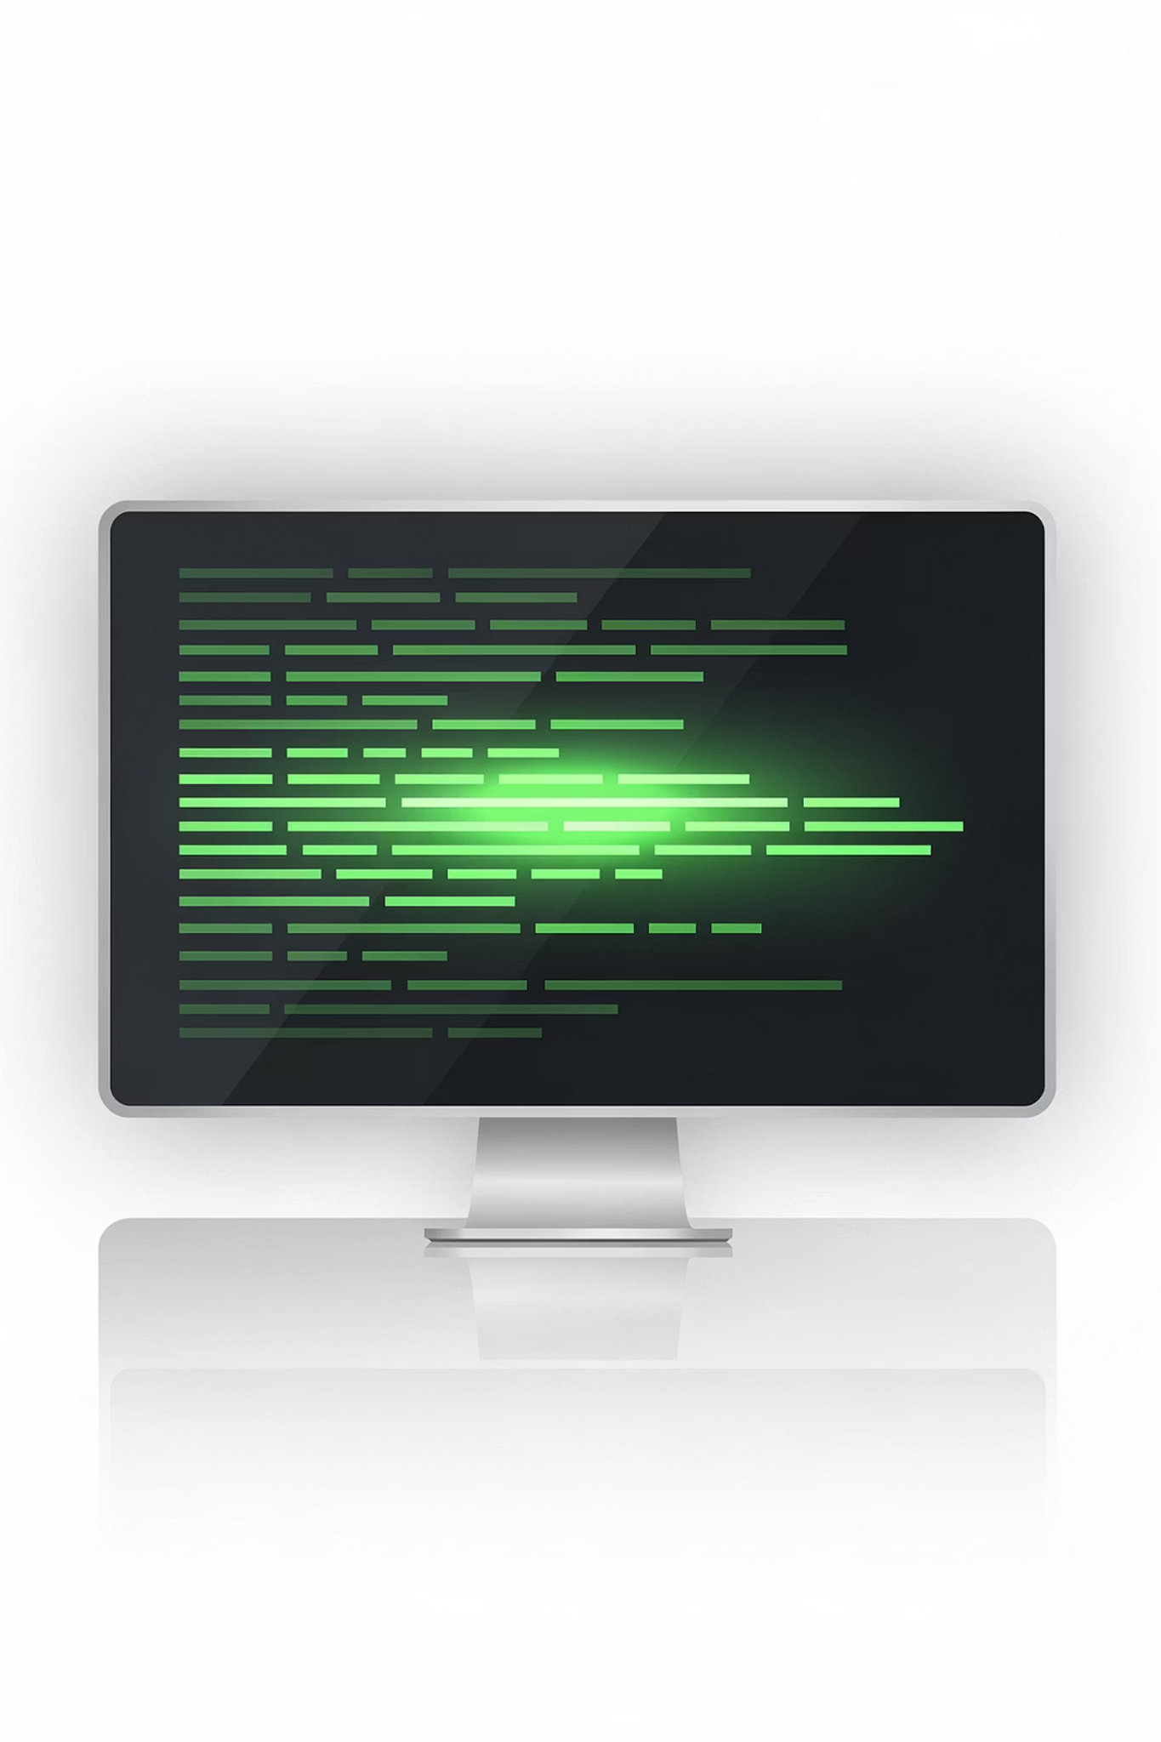

Linux & Command Line Culture
Understanding Linux & the Power of the Terminal
1

Slide 2
Session Agenda
01
02
What is an Operating System?
Why Linux Dominates the Cloud
03
04
CLI vs GUI Mindset
Open-Source Concept
05
06
Linux in Real World
Basic Linux Commands Demo
07
08
Hands-on Challenges
Scenario Discussion
2

Slide 3
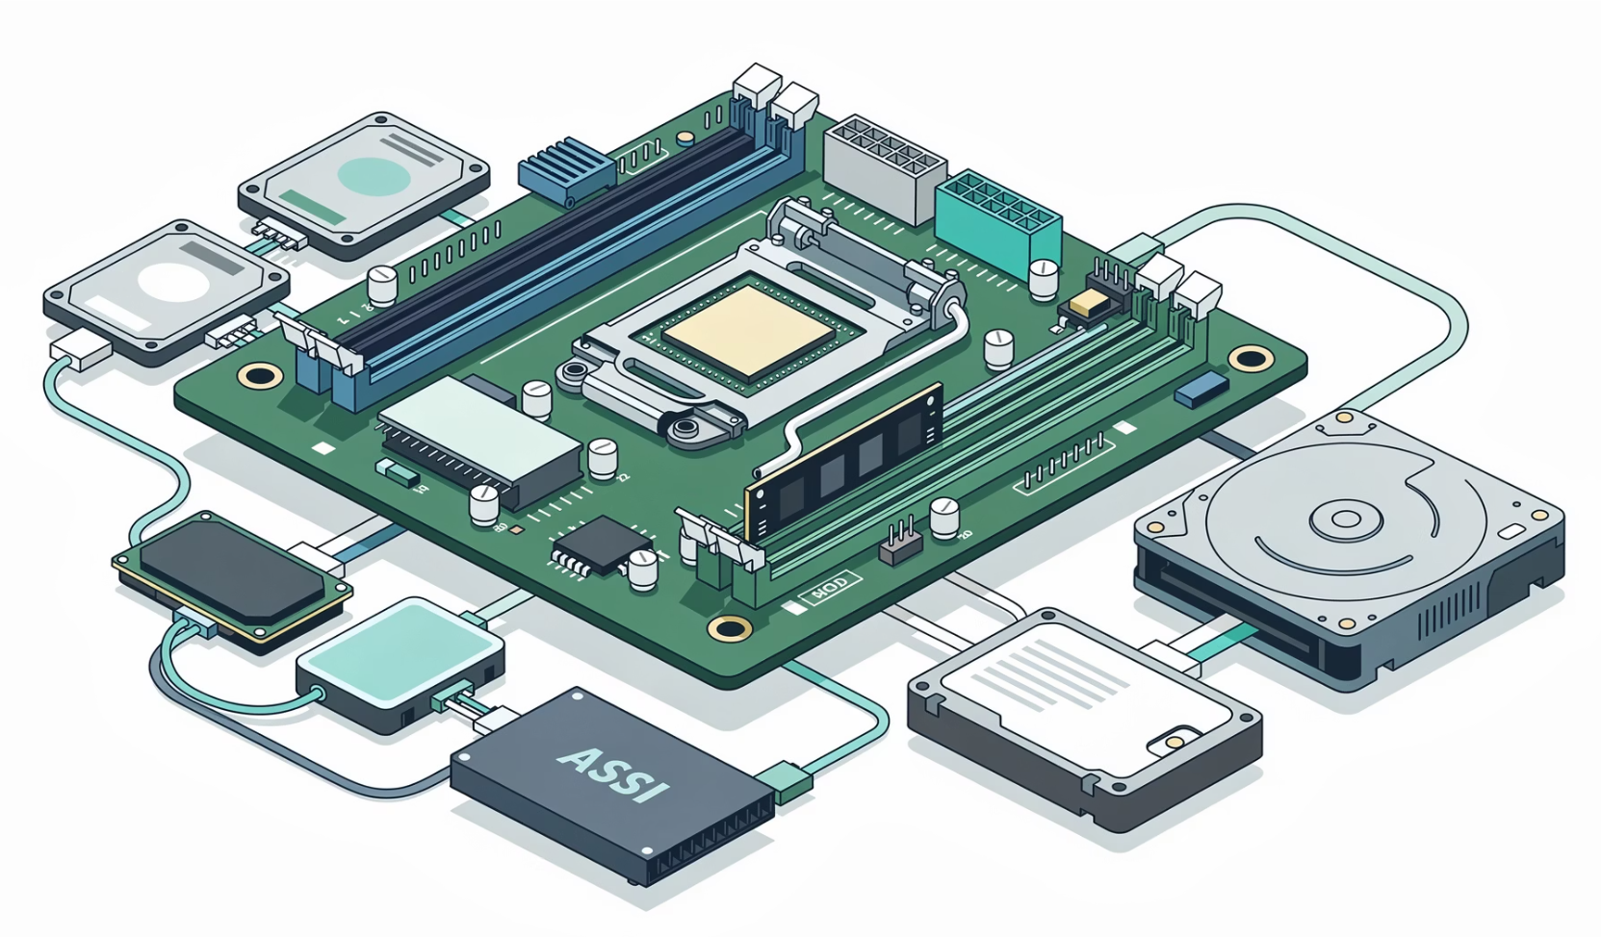




CONCEPT INTRODUCTION
What is an Operating System?
An OS manages hardware resources, runs applications, provides a user interface, and controls CPU, RAM, and Storage.
Without an OS → Computer cannot function.
Linux
Windows
macOS
3

Slide 4
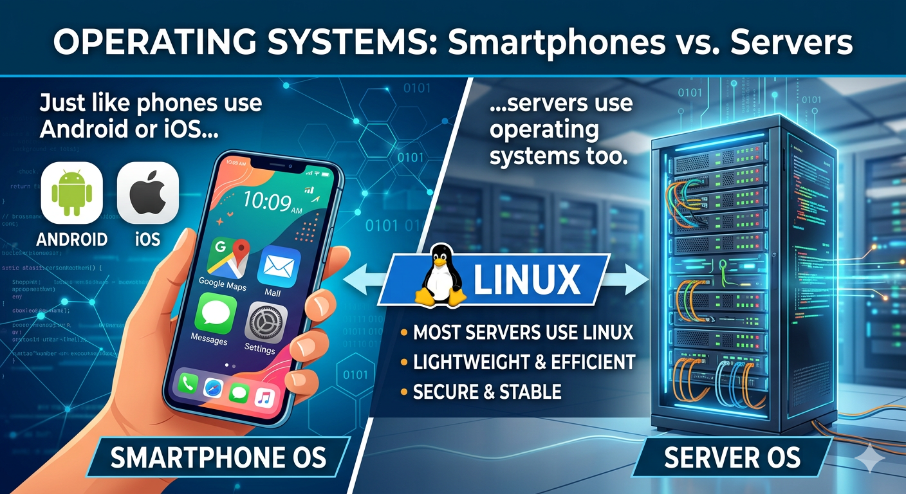



CONCEPT INTRODUCTION
What is Linux?
Linux is a kernel. Many distributions are built on top of it.
Open-Source
Example: Smartphone OS
1
Publicly available source code
Secure & Stable
2
Trusted for critical systems
Customizable
3
Servers, cloud, embedded systems
Ubuntu
CentOS
Debian
4

Slide 5





CONCEPT INTRODUCTION
Why Does Linux Dominate the Cloud?
Free & Open-Source
No licensing costs, community-driven
Secure & Lightweight
Strong security with minimal resource usage
Easily Automated
Excellent for scripting and DevOps workflows
Most cloud servers run Linux.
5

Slide 6
Quiz Time
Q1. What is Linux?
✅ Answer: Linux is an open-source operating system kernel used to run computers and servers.
Q2. Why do many cloud servers run Linux?
✅ Answer: Because Linux is free, secure, stable, and uses fewer resources, which makes it ideal for servers.
Q3. What is a Linux distribution?
✅ Answer: A Linux distribution is a complete operating system built using the Linux kernel.
6

Slide 7
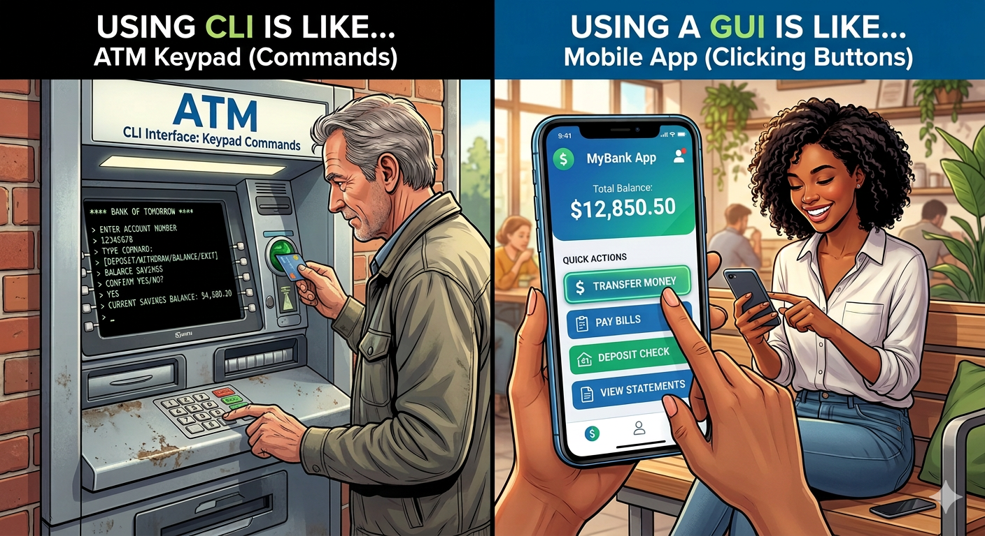
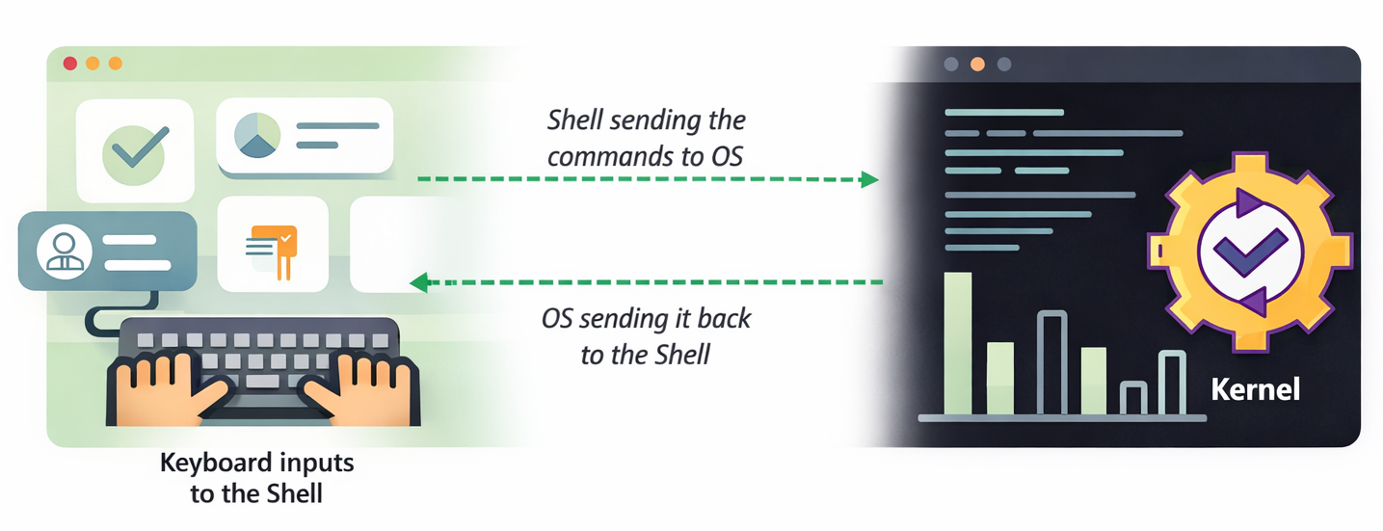
CLI VS GUI MINDSET
GUI vs CLI
Example: ATM vs Mobile App
GUI — Graphical User Interface
Visual, mouse-driven, beginner-friendly.
Click a folder → open a file.
Used in: Windows, macOS
CLI — Command Line Interface
Text-based, keyboard-driven, fast & powerful. Used on servers.
DevOps engineers prefer CLI for automation.
7

Slide 8
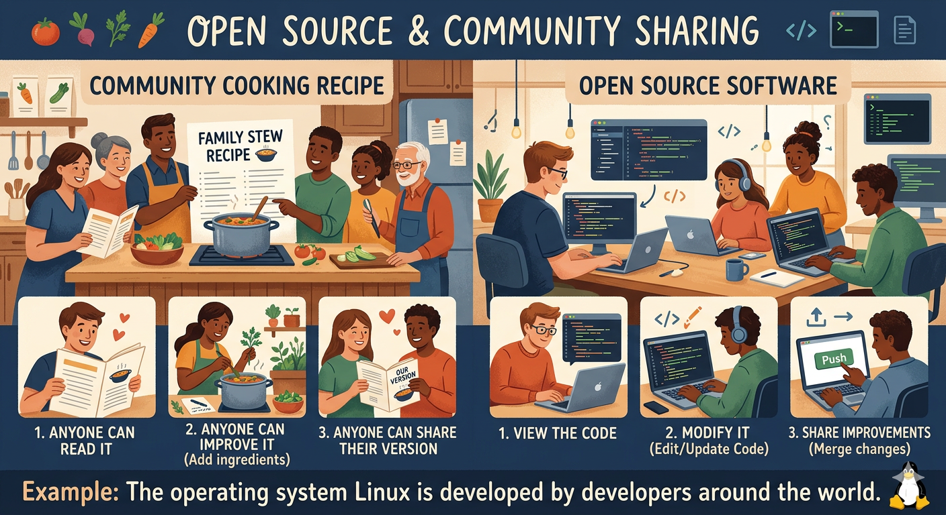


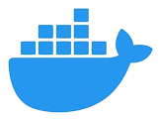



OPEN-SOURCE CONCEPT
What is Open Source?
Example: Community Cooking Recipe
Open-source software has publicly available source code that anyone can modify and improve — driven by community collaboration.
Examples: Linux, Git, Docker
Transparency
Security
Innovation
8

Slide 9
Quiz Time
Q1. What does “open source” mean in software?
✅ Answer: Open source means the source code of the software is publicly available, and anyone can view, modify, and improve it.
Example: The operating system Linux is open source, so developers around the world contribute improvements.
Q2. Why do many companies use open-source software?
✅ Answer: Because it is free, customizable, and supported by a large developer community.
Example: Many websites run on the web server Apache HTTP Server, which is an open-source project maintained by
developers worldwide.
Q3. How can developers contribute to open-source projects?
✅ Answer: Developers can contribute by fixing bugs, adding new features, improving documentation, or reporting issues.
Example: Developers contribute code and improvements to projects on GitHub, where many open-source projects are hosted.
9

Slide 10



REAL-WORLD EXAMPLES
Linux in Cloud Providers
The world's largest cloud platforms run Linux internally. Most virtual machines are Linux-based.
Amazon Web Services
Microsoft Azure
Google Cloud
10

Slide 11



REAL-WORLD EXAMPLES
Why DevOps Engineers Prefer the Terminal
Remote Server Access
Connect via SSH from anywhere
Automation via Scripts
Repeat tasks with a single command
Faster Troubleshooting
Diagnose issues without a GUI
Low Resource Usage
No GUI overhead on production servers
Production servers rarely have a GUI installed.
11

Slide 12





DEMO SECTION
Basic Linux Commands
These five commands form the foundation of navigating and managing files in any Linux environment.
pwd
mkdir
Show current directory
Create a new directory
ls
touch
List files and folders
Create an empty file
12

Slide 13
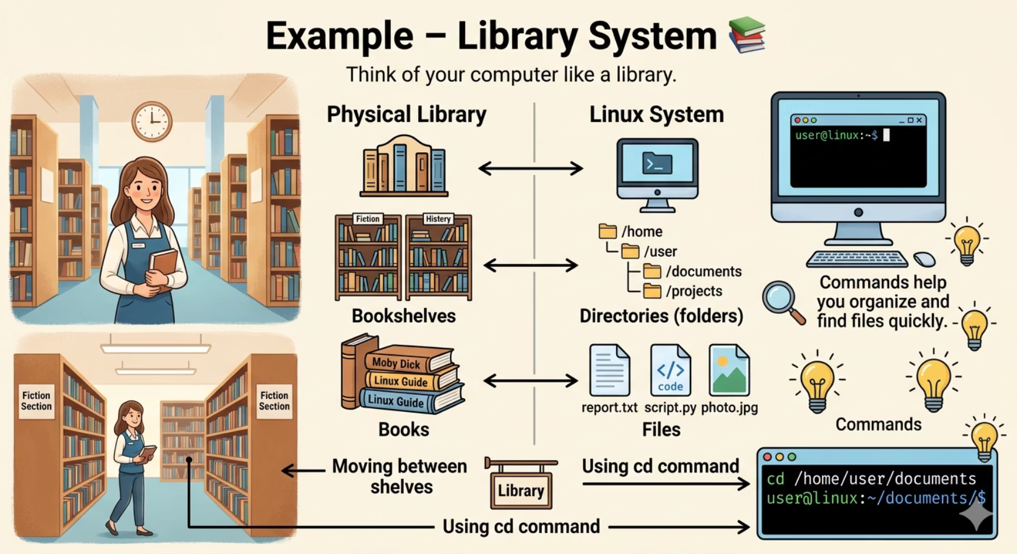
DEMO SECTION
Basic Linux Commands
Linux — Command
File navigation
Directory structure
Creating files
Creating folders
Viewing file content
13

Slide 14
DEMO SECTION
pwd & ls Commands
pwd — Print Working Directory
ls — List Files
Shows your current location in the filesystem.
ls # basic list
ls -l # detailed list
ls -a # show hidden files
pwd
/home/user
14

Slide 15
DEMO SECTION
mkdir, touch & cat Commands
mkdir
touch
cat
Make Directory
Create Empty File
View File Content
mkdir project
touch file.txt
cat file.txt
Creates a folder named "project"
Creates an empty file
Displays file content
15

Slide 16
PRACTICAL ACTIVITY
Create a Project Folder Structure
Target Structure
Commands
project/
├── src/
├── docs/
├── tests/
└── README.txt
mkdir project
cd project
mkdir src docs tests
touch README.txt
16

Slide 17
PRACTICAL ACTIVITY
Navigate Directories Challenge
Commands to Practice
. (dot)
cd src # enter src folder
cd .. # go up one level
cd docs # enter docs folder
cd / # go to root
Current directory
.. (double dot)
Parent directory
/ (slash)
Root directory
17

Slide 18
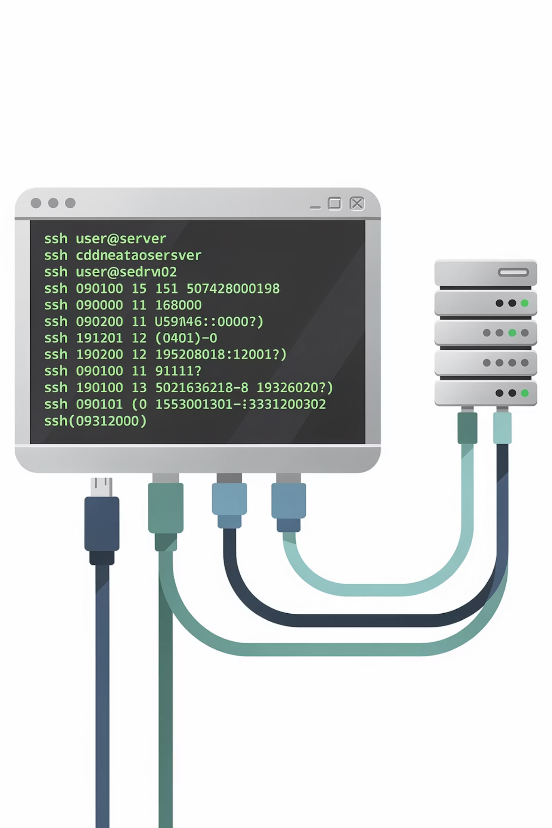
SCENARIO DISCUSSION
Scenario 1: You Are Given a Server
You connect via SSH. No GUI is available.
Can you manage everything using CLI?
Navigate files
Create directories
Read file content
18

Slide 19

SCENARIO DISCUSSION
Scenario 2: You Cannot Find a File
pwd
ls -a
Check spelling
Hidden files
Print working directory command
List all files including hidden
Verify text for correctness
Files not visible by default
Systematic CLI troubleshooting helps you locate any missing file quickly and confidently.
19

Slide 20
SCENARIO DISCUSSION
Scenario 3: Project Setup Challenge
Create
webapp/
├── backend/
├── frontend/
└── config/
What commands are needed?
20

Slide 21




SUMMARY
Key Takeaways
Linux Basics
Cloud Dominance
Open-source kernel powering cloud, servers & embedded systems
Free, lightweight, secure — the default OS for cloud infrastructure
CLI Mindset
Commands & Navigation
Text-based control preferred by DevOps for speed & automation
pwd, ls, mkdir, touch, cat — plus hidden files & directory traversal
21

Slide 22


Thank You
22

